Slide 1
Chapter 13
Architectural Design

Slide 2
Topics
The concept of Architecture Design
Architectural Styles and a brief taxonomy of Architectural Styles
Architectural Design
Data Design
Assessing alternative architectural designs
Discussion：Pattern-based architectural design(chapt.16)

Slide 3
An Example
customer requirements
"four bedrooms, three baths,
lots of glass ..."
architectural design

Slide 4
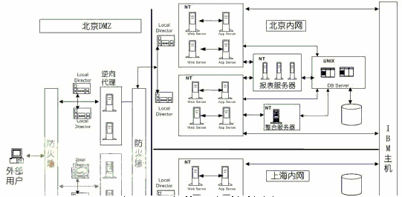
A physical architecture example

Slide 5
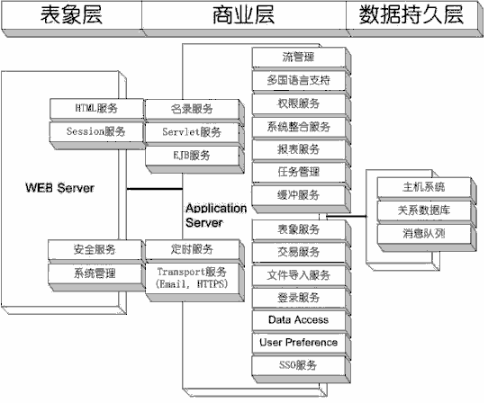
A logical architecture example

Slide 6
What is Architecture?
The software architecture of a program or computing system is the structure or structures of the system, which comprise software elements, the externally visible properties of these elements, and the relationships among them. - Len Bass, Paul Clements, Rick Kazman
Software Architecture in Practice, Second Edition

Slide 7
What is Architectural Design?
The architecture of a system is a comprehensive framework that describes its form and structure----its components and how they fit together.
It represents the structure of data and program components that are required to build a computer-based system.
It considers following factors:
  architectural style of system;
  structure of the components;
  properties of the components;
  the interrelationships of components;

Slide 8
Notes
Software architecture must model the structure of a system and the manner in which data and procedural components collaborate with one another.
The architecture is not the operational software. Rather, it is a representation that enables a software engineer to:
  (1) analyze the effectiveness of the design in meeting its stated requirements,
  (2) consider architectural alternatives at a stage when making design changes is still relatively easy, and
  (3) reduce the risks associated with the construction of the software.

Slide 9
Why is Architecture Important?
Representations of architecture are an enabler for communication between all stakeholders.
The architecture highlights early design decisions and as important as an operation entity.
Architecture “constitutes a relatively small, intellectually graspable model of the system”.

Slide 10
Architectural Styles

Slide 11
What are Architectural Styles?
Each style describes a system category that encompasses:
(1) a set of components (e.g., a database, computational modules) that perform a function required by a system;
(2) a set of connectors that enable “communication, coordination and cooperation” among components;
(3) constraints that define how components can be integrated to form the system;
(4) semantic models that enable a designer to understand the overall properties of a system by analyzing the known properties of its constituent parts.

Slide 12
A Brief Taxonomy of Architectural Styles
Data-centered architectures
Data flow architectures
Call and return architectures
Object-oriented architectures
Layered architectures

Slide 13
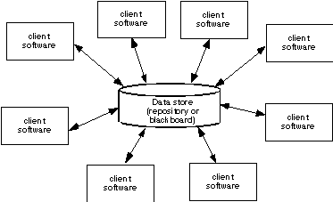
Data-Centered Architecture
Data store lies at the center and is accessed frequently by other components that modify data

Slide 14
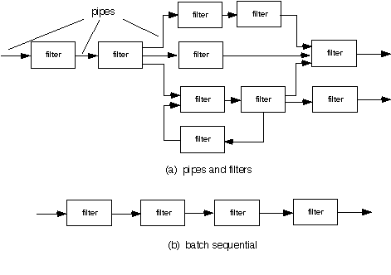
Data Flow Architecture
Input data is transformed by a series of computational or manipulative components into output data

Slide 15
Pipes and Filters Architecture example
Examples
  UNIX shell: ls invoices | grep -e August | sort
  Signal processing

Slide 16
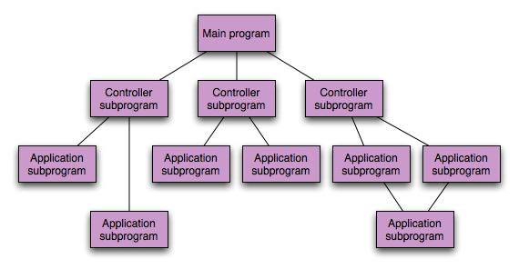
Call and Return Architecture
program structure decomposes function into control hierarchy with main program invokes several subprograms

Slide 17
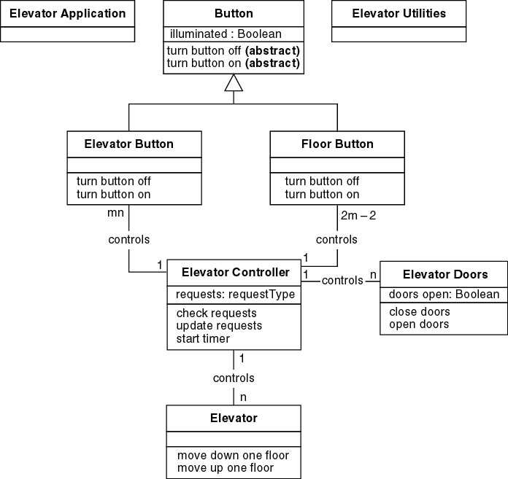
Object-Oriented Architectures
components of system encapsulate data and operations, communication between components is by message passing

Slide 18
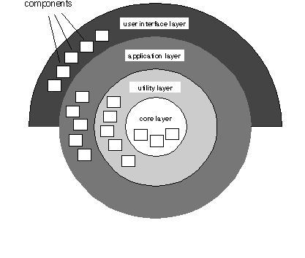
Layered Architecture
Each layer accomplishes operations that progressively become closer to the machine instruction set

Slide 19
Typical Layering Approach
Specific functionality
Distinct application subsystems that make up an application — contains the value adding software developed by the organization.
Application
Business specific — contains a number of reusable subsystems specific to the type of business.
Business-Specific
Middleware — offers subsystems for utility classes and platform-independent services for distributed object computing in heterogeneous environments and so on.
Middleware
System software — contains the software for the actual infrastructure such as operating systems, interfaces to specific hardware, device drivers, and so on.
General functionality
System Software
Notes:
This is a repeat of the slide first introduced in Architectural Analysis. It is included here as a review.
During Architectural Analysis, the focus was on the upper-level layers (that is, the application and business-specific layers). During Identify Design Elements, the focus is on the lower-level layers.
The layering principles originally described for packages also apply to subsystems.
This graphic comes from RUP.

Slide 20
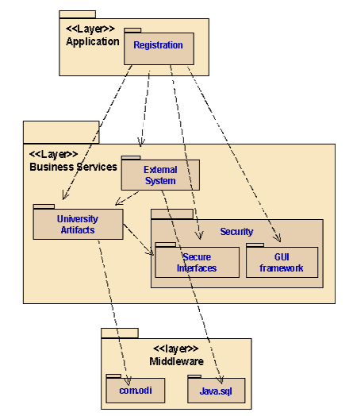
Layered Architecture Example
Three-tiered architecture of
Students Course Registration System

Slide 21
Architectural Patterns
Concurrency
  operating system process management
  task scheduler
Persistence
  a database management system pattern that applies the storage and retrieval capability of a DBMS to the application architecture
  an application level persistence pattern that builds persistence features into the application architecture
Distribution-the manner in which systems or components communicate with one another in a distributed environment
  A broker acts as a ‘middle-man’ between the client component and a server component.
  CORBA

Slide 22
Architectural Design

Slide 23
Architectural Design
Representing the system in context: Architectural context diagrams model how software interacts with external entities
Defining Archietypes:
Archetypes are classes or patterns that represent an abstraction critical to the system
Refining the architecture into componens: system in contet: Architectural components are derived from the application domain, the infrastructure, and the interface.

Slide 24
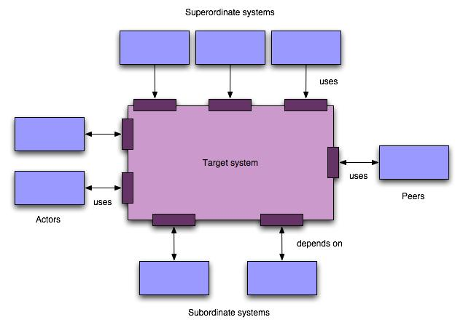
Arch. Context Diagram

Slide 25
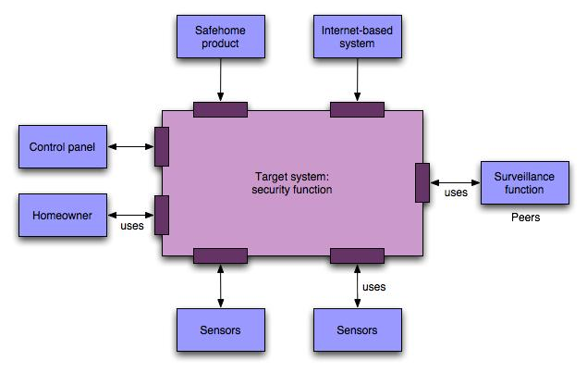
SafeHome ACD

Slide 26
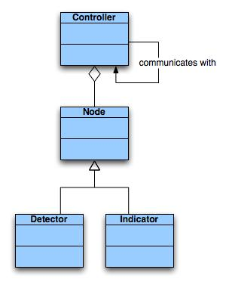
SafeHome Archetype

Slide 27
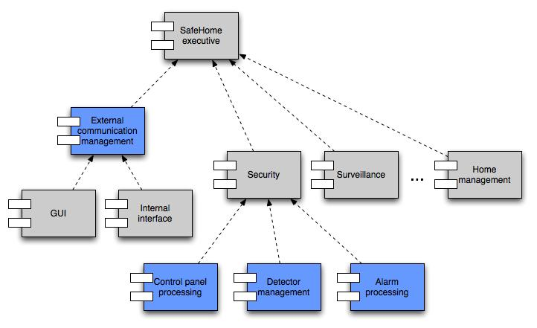
Component Structure

Slide 28
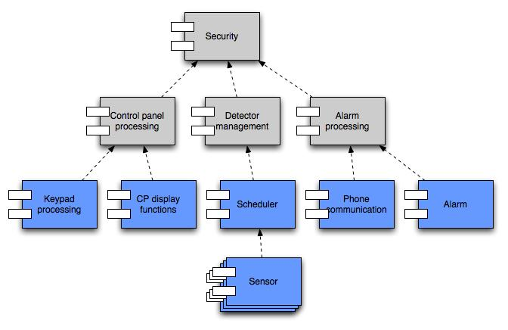
Component Elaboration

Slide 29
A method for Architectural Design

Slide 30
Deriving Program Architecture
Program
Architecture

Slide 31
Structured Design
objective: to derive a program architecture that is partitioned
approach:
  a DFD is mapped into a program architecture
  the PSPEC and STD are used to indicate the content of each module
notation: structure chart

Slide 32
Flow Characteristics
Transform flow
Transaction
flow

Slide 33
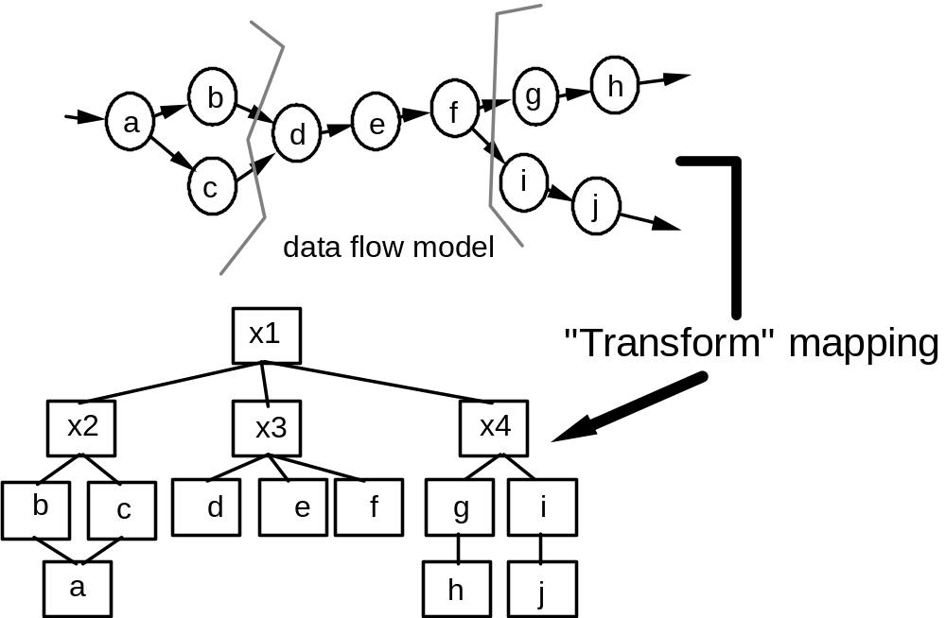
Transform Mapping

Slide 34
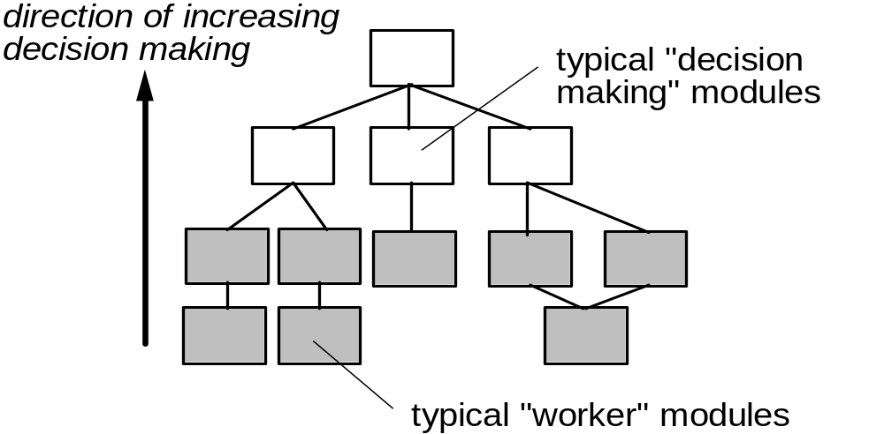
Factoring

Slide 35
First Level Factoring
main
program
controller
input
processing
output
controller
controller
controller

Slide 36
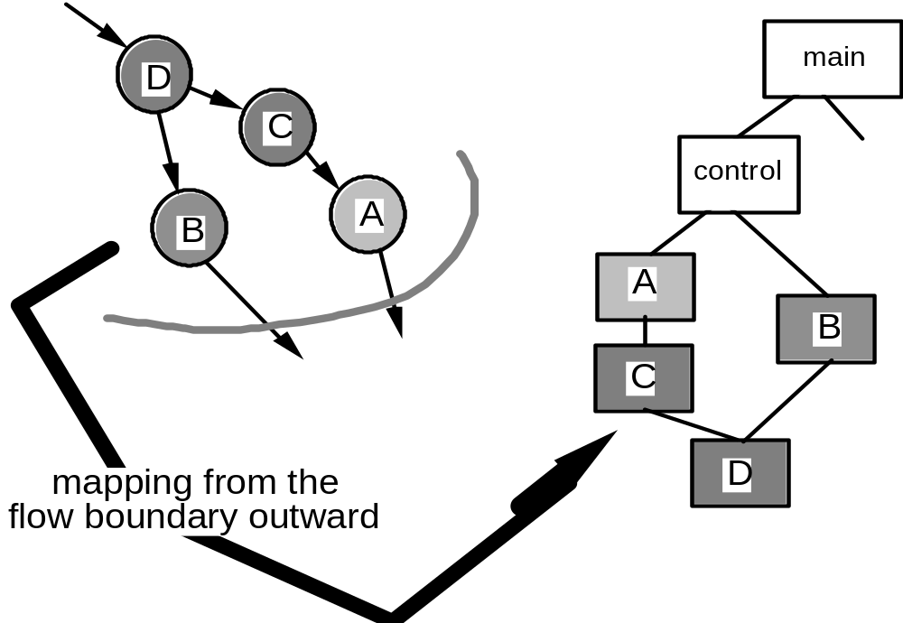
Second Level Mapping

Slide 37
Data Design

Slide 38
What is Data Design?
Data design ( data architecture ) creates a model of data and/or information.
It is the first step of design.
It is an important part of design.
It has a profound influence over the architecture.
We must do data design at following levels:
  components level (data structures);
  application level (database);
  business level (data warehouse);

Slide 39
The Main Activities of Data Design
refine data objects and develop a set of data abstractions
implement data object attributes as one or more data structures
review data structures to ensure that appropriate relationships have been established
simplify data structures as required

Slide 40
Data Design at Three Levels
The data design translates ERD and DD of the requirements model into:
  Data structure at the software component level;
  Database architecture at the application level;
  Data Warehouse at business IT community level;

Slide 41
Data Design at the Component Level
1. The systematic analysis principles should also be applied to data design.
2. All data structures and the operations should be identified.
3. A data dictionary should be used to define both data and program design.
4. Low level data design decisions should be deferred until late in the design process.
5. The representation of data structure should be known only to the relative modules.
6. A library of data structures and operations should be developed.
7. A software design and programming language should support the specification and realization of abstract data types.

Slide 42
Data Design at the Application Level
Example: Database
translate the ERD to the model of relational database.
  From Entity to Table;
  From Attribute to Field;
  From Relation to Table;

Slide 43
From ERD to Database architecture
步骤：
  实体集合转换成关系模式，实体集合的属性成为关系的属性，实体集合的关键字成为关系的关键字；
  联系转换成关系模式，参加联系的 实体集合关键字成为关系的属性，其关键字按照联系的类型确定：
    1:1联系，参加联系的任意一实体集合的关键字成为关系的关键字；
    1:N联系，N的一方的实体集合的关键字成为关系的关键字；
    N:M联系，参加联系的所有实体集合的关键字成为关系的关键字；

Slide 44
Example
a
d
E1
n
R
m
E2
b
e
c
关系模式：
  E1 ( a, b );
  E2 ( d, e );
  R ( a, d, c );

Slide 45
Data Design at the Business Level
Example: a data warehouse
A data warehouse is a large, independent database that encompasses the data used by a business.
Data warehouse comes from database but not typical database:
  Subject Orientation;
  Integration;
  Time Variance;
  Non-volatility;

Slide 46
Assessing Alternative Architectural Designs

Slide 47
Analyzing Architectural Design
ATAM(Architectural Trade-off Analysis Method)
1. Collect scenarios.
2. Elicit requirements, constraints, and environment description.
3. Describe the architectural styles/patterns that have been chosen to address the scenarios and requirements:
• module view
• process view
• data flow view
4. Evaluate quality attributes by considered each attribute in isolation.
5. Identify the sensitivity of quality attributes to various architectural attributes for a specific architectural style.
6. Critique candidate architectures (developed in step 3) using the sensitivity analysis conducted in step 5.

Slide 48
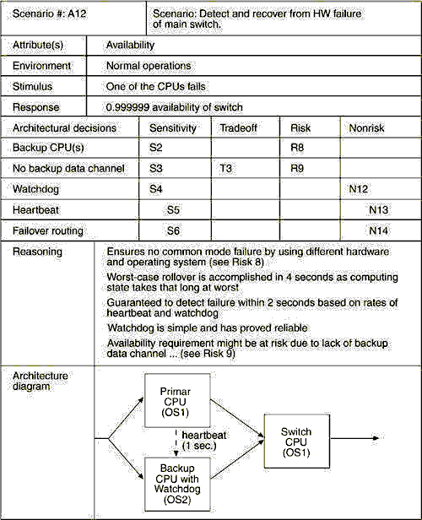
上午 01:11
79

Slide 49
ADL
Architectural description language (ADL) provides a semantics and syntax for describing a software architecture
Provide the designer with the ability to:
  decompose architectural components
  compose individual components into larger architectural blocks and
  represent interfaces (connection mechanisms) between components.

Slide 50
Discussion:
Pattern-based architectural design(chapt.16)

